Slide 1


SAP BTP Training
Cloud Foundry Training

Slide 2

DISCLAIMER
The training content and delivery of this presentation is confidential, and cannot be recorded, or copied and distributed to any third party, without the written consent of Anubhav Trainings

Slide 3

LEARNING OBJECTIVES
SAP BTP CAPM Development
Manage Aspects
Managed localizations
Create EPM Tables
CDS Views in CAPM
Create Services
Setup Business Application Studio

Slide 4





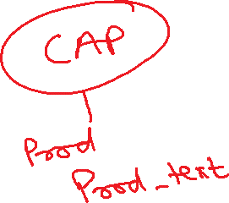




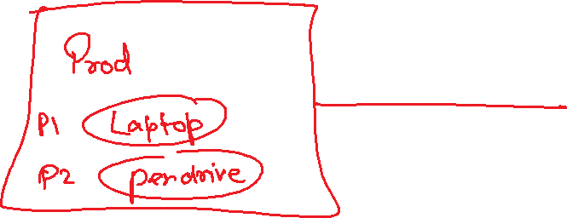

Slide 5
Create EPM Data Model
Product Texts
Addresses
Business Partners
(Customer, Vendor)
1 *
Purchase Orders
Products
1..*
https://www.youtube.com/watch?v=1tk4DUOXXQw
Purchase Order Items
www.anubhavtrainings.com

Slide 6
Language Dependent Data – text Tables
Following are the dis-advantages of classical technique
We have to manually create the text table
To read data a developer need to code association and also pass the language value manually @ runtime
www.anubhavtrainings.com

Slide 7
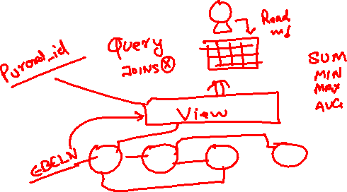
CDS Views
Why we need views in a software
They display non-normalized data. The data is spread in multiple tables, and it is difficult for developers to every time write JOINs.
The application needs data which is presentable to user
View gives security because users cannot update data using view
They can aggregate data like find total sales per customer.
Expose columns of technical type to more semantic names
www.anubhavtrainings.com

Slide 9
Business Application Studio
SAP Business Application Studio is a development environment available on SAP Business Technology Platform. Before you can start developing using SAP Business Application Studio, administrators must perform the required onboarding steps to create CAPM applications on cloud.
www.anubhavtrainings.com

Slide 10

Summarize
LET’S SUMMARISE!

Slide 11

Summarize
End of Day 11

Slide 13


We’re committed to empower you to be
#FutureReady
through powerful training solutions.
We build the workforce of the future.
250+
Corporate Clients
30,000+
Learners Trained
25000+
Learners Placed
FREE WEBINARS
Sign up for free webinars with industry experts every fortnight!
Enroll Now!
Contact us today!
https://anubhavtrainings.com

